Slide 1
CHIPPWORDS passwords simplified!
Snehitha Barukula
AP18110010438
CSE G

Slide 2
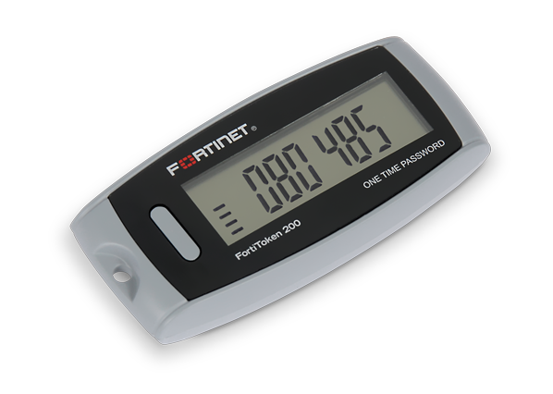

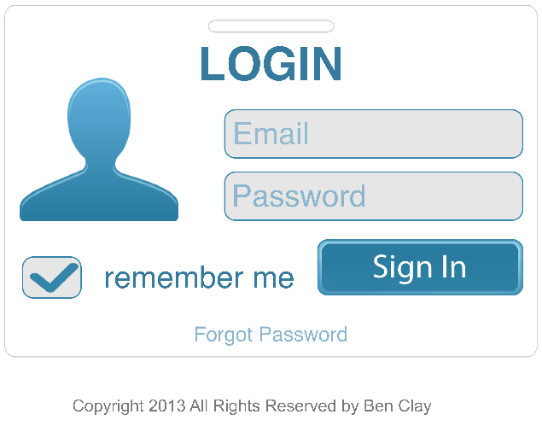
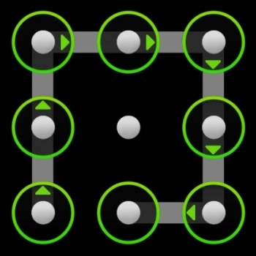

CONTENTS
Introduction
Classification of Authentication
schemes
Existing Systems
System Requirements
Proposed System
Results
Conclusion
References

Slide 3
INTRODUCTION
Chippword is a multifactor authentication scheme where a 3D passwords are customized.
As the human brain as to run across the facts of recalling , recognising, biometrics and token-based authentication, we combine all the existing schemes into one single 3D virtual environment.
A virtual environment is a networked application that enables a user to interact with both computing and the work of the users.
The 3D virtual room has several virtual objects for the user to interact.
It is the task of the system administrator to design the environment and to select the appropriate object that reflects the protected system requirements.

Slide 4
INTRODUCTION
Virtual objects could be any real object that we encounter in our daily lives.
The choice of selecting the authentication system will be part of the user’s Chippword which reflects the users preference and requirements.
The Chippword is still in its initial stage and yet designing of various virtual environments, password spaces and interpreting user’s feedback and experience from such environments will improve the need of 3
The user can traverse around the virtual room and interact with the objects and the password is created by tracing the users actions and interactions.
The type of interaction varies from one object to another.

Slide 5
Classification of Authentication Techniques
Human Authentication techniques
Knowledge Based What you KNOW
ATM cards
Keys
Biometrics - What you ARE
Fingerprints, Palmprints
Token Based-What you HAVE
Textual Password
Graphical Password
ID Cards
Hand geometry
Face, Iris, Voice, Retina recognition

Slide 6
EXISTING SYSTEMS
3D passwords were first recognised by Blonder in 1996
Later then Dhamig and Perig developed a recognition based graphical password system.
The systems that are commonly known are:
Textual passwords
Graphical passwords
Biometrics and
Token based
With the rapid change in the technology, fastest processors and many tools available in the internet cracking one’s password has become as easy as falling off a log. Few years back Klein performed such experimental tests and passed to crack at least 10 passwords a day

Slide 7
EXISITING SYSTEMS
Later then Dhamig and Perig developed a recognition based graphical password system. The user has to select a portfolio from given portfolios that include randomized art.
The main application of the domain is to protect the critical systems
and resources:
Critical Servers
Military Facilities
Airplanes and Missile Guiding
Limitations: Human features are exposed to nature and may transform over a period of time.
People are not convenient with biometrics all the time. They resist sometimes as having a copy of user’s finger print is not safe and may be used for fraud.
Biometrics cannot be nullified, which leads the user to a dilemma in the data that has been forged. Unlike other authentication systems where the user can create a new password if he/she forgets the current passwords, Biometrics are unique and cannot be replaced.

Slide 8
SYSTEM REQUIREMENTS
This application uses java technology. The virtual room is called 3D arena is a .obj file and it is downloaded and then coded into java technology.
Software requirements: windows XP / windows 10
NetBeans IDE/Eclipse IDE
Arena 3d model
Hardware components: processor:
i3 or latest
Memory – 1gb ram

Slide 9
PROPOSED SYSTEM
Assuming that the user uses any input device like mouse, keyboard, iris scanner, fingerprint scanner etc. to navigate along the room.
For example, The user enters the virtual environment and he types something on the computer that exists in the position (x1,y1,z1) and then he enters the room that contain the fingerprint recognition system that exists in position (x2,y2,z2) and provide the fingerprint. Later he has to go to the virtual game room and adjust the chess pieces on the board. The combination of previous action of the user to the specific object creates his Chippword.
We consider the path in which the user interacts with previous input devices as his 3D password.

Slide 10
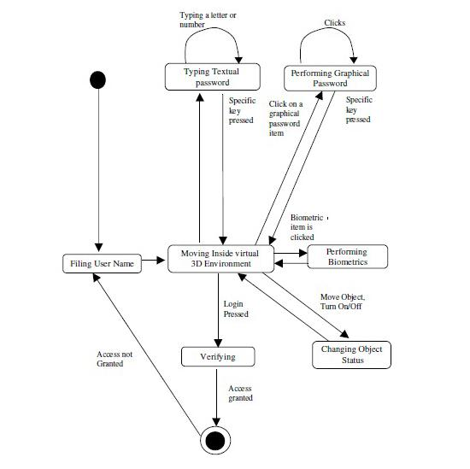
STATE DIAGRAM

Slide 11
PROPOSED SYSTEM
Time complexity : assuming that A is virtual environment and B is algorithmic processing. Then,
Time complexity = A^m +B^n
where m is time required to communicate with the system and n is the time required to process each algorithm in the virtual environment.
Space complexity: The 3D password is stored as a database in the system as (x, y, z) coordinate point. Since it is a 3D password the three dimensions are considered for virtual environment.

Slide 12
PROPOSED SYSTEM
Brute Force algorithm: As discussed earlier when the virtual room appears the user will have to traverse with different actions and reactions. The algorithm followed here is brute forced with n number of possibilities for a password. Although we need to take few considerations into account
the time required to login: According to the research and study the time taken for a successful login varies and depends upon the no. of obvious actions and reactions by the user.
the total cost required: on the other hand, we need to create a 3D virtual environment and creating such an environment is quite expensive.

Slide 13
RESULTS
The 3D password space can be calculated by using π(Lmax, K) on a 3D virtual room that has space (k*k*k) for a password of length Lmax or less.
Mathematically, П (Lmax, G) = ∑ (m + g (AC)) n.
In the above expression:
g(AC) represents total no of actions and interactions made with the environment.
Lmax is the maximum length of the password the user can put which is generally the images on each side of the cube
M stands for possible no. of actions towards the objects in the environment.
Therefore, the value of the equation gives the total no of spaces required to store password for the 3D environment.

Slide 14
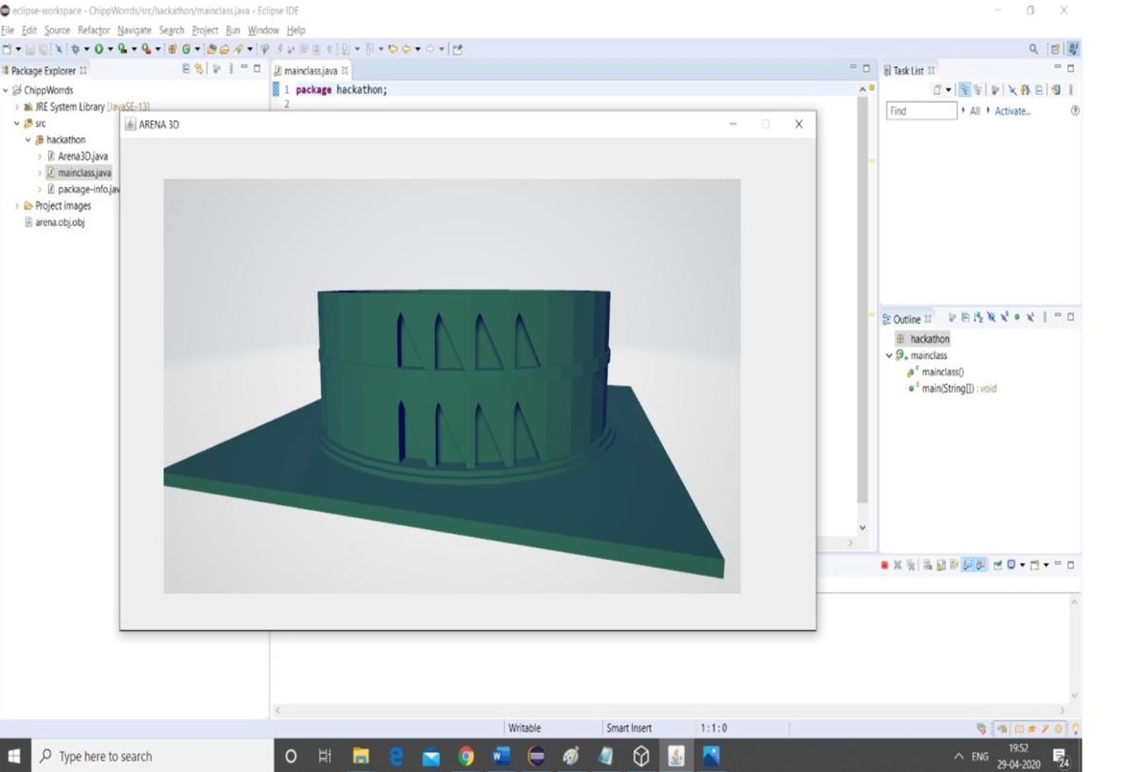
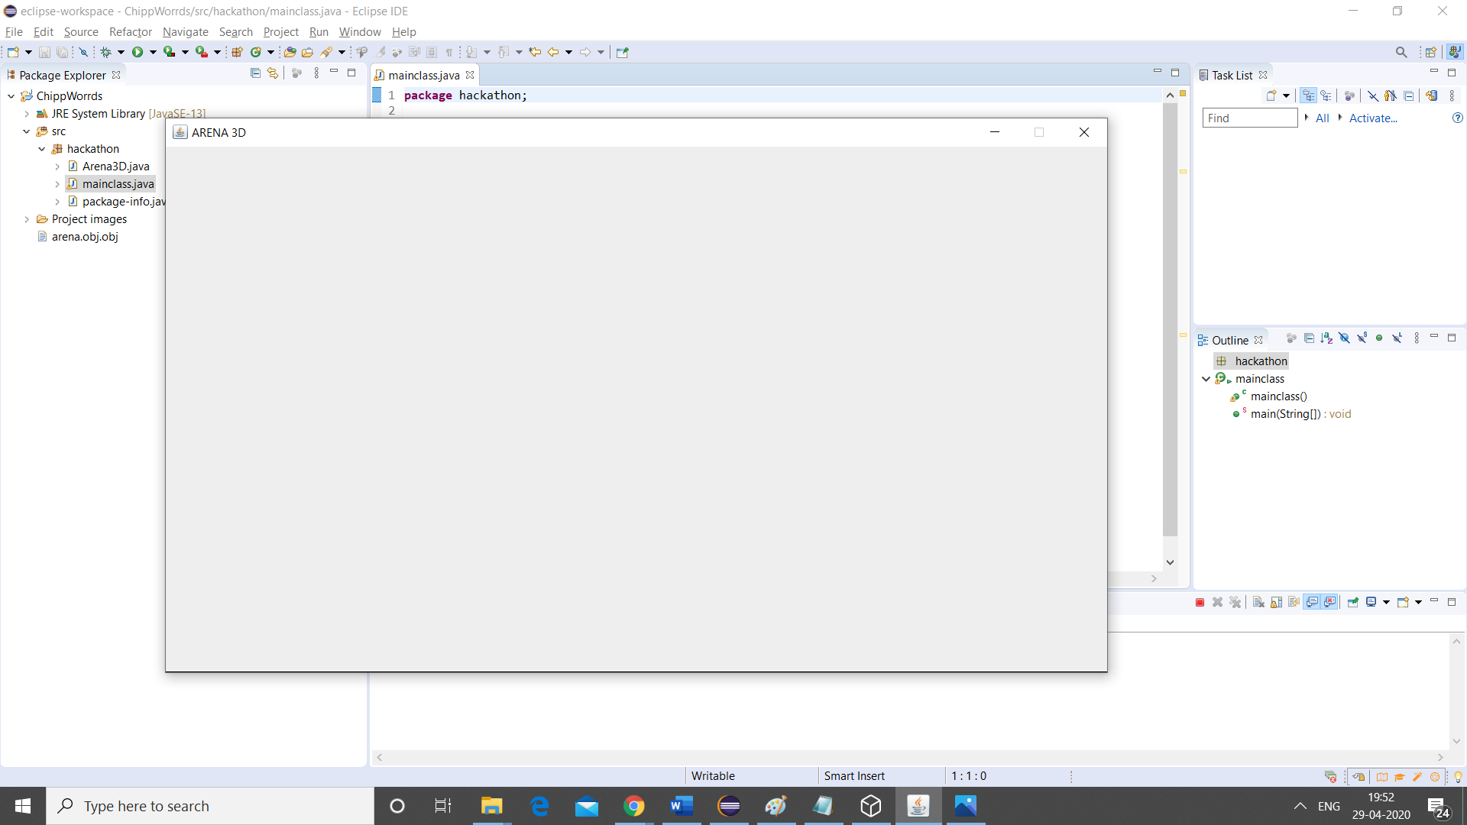
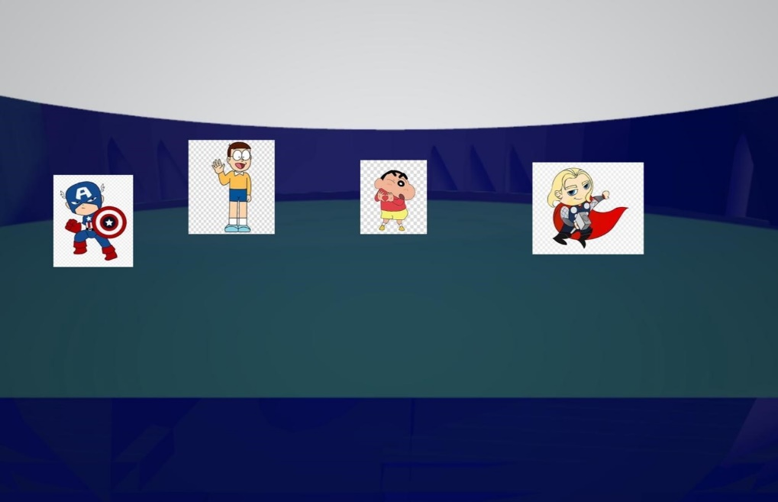
RESULTS

Slide 15
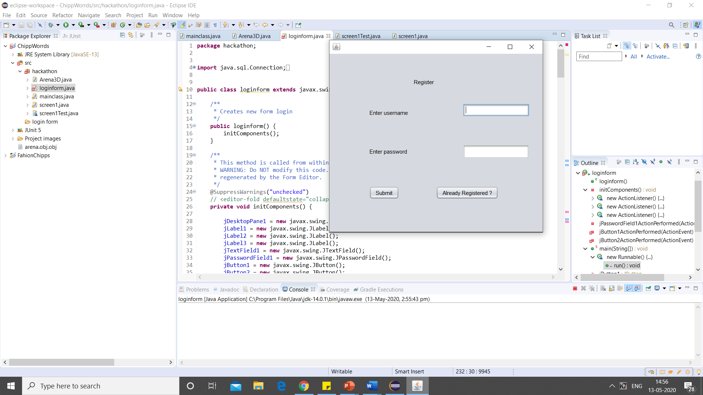
RESULTS
The graph represents the no. of possible actions and reactions of a Chippword within the 3D environment. The size of each bit in Klein study is (3* 10^6) dictionary of eight-character textual password

Slide 16
CONCLUSION
Since Chippword is a multi-factor authentication scheme that is combination of various authentications into a single 3D virtual environment. The virtual room contains every other existing authentication schemes or even any other updated authentication schemes by simply appending it as a response to the actions performed on an object. Hence, the password space becomes large compared to any other authentication schemes. Designing a simple 3D virtual room is a fact that leads to a higher user acceptability of a Chippword system. The choice of which authentication scheme to be used will be part of user's 3D password reflects the user's preferences and requirements, depending on his security requirements. The future work of the researchers should include how to overcome gathering attacks from different background activities

Slide 17
REFERENCES
[1] G.E. Blonder, “Graphical Password,” U.S Patent 5 559 961, Sep.24, 1996.
[2] study of three - dimensional password authentication system. (2016), Retrieved from
https://ijarcce.com/wp-content/uploads/2016/11/IJARCCE-ICRITCSA-27.pdf
[3] A Framework for secured 3D password using Genetic Algorithm. (2015), Retrieved from
https://www.researchgate.net/publication/271508763_A_Framework_for_Secure_3D_Password_using_Genetic_Algorithm
[4] 3D Password Based Authentication System Using Multiple Layers. (2014), Retrieved from
https://www.researchgate.net/publication/276281665_3D_Password_Based_Authentication_System_Using_Multiple_Layers
[5] Virtual Realization Using 3D password. (n.d), Retrieved from
https://pdfs.semanticscholar.org/6c5a/98ccf829fd49be6cffd6642491dea0806ee8.pdf
[6] Security Using 3D Password. (2015), Retrieved from
http://citeseerx.ist.psu.edu/viewdoc/download?doi=10.1.1.695.6431&rep=rep1&type=pdf

